Slide 1
Prediction of Heart Disease in a patient by using Machine Learning Algorithms
Mahesh Ganta Pilli
UID: U01064382

Slide 2
Overview
Problem Statement
Introduction and Dataset collection
Data Pre-Processing
Feature Selection
Machine Learning methods
Final Evaluation Results
Conclusion

Slide 3
Problem Statement
Now a days, common cause of death in aged people is mainly because of Cardiovascular disease (CVD).
Estimated global deaths per year: 17.9 million. One-third of these deaths are occurring prematurely in people under 70 years of age.
In order to enhance patient healthcare outcomes, it is crucial to apply cutting-edge approaches and techniques in bio-medical data analysis to identify and diagnose heart disease at an early stage.

Slide 4
Introduction and data collection
The project's main goal is to evaluate the patient health data using machine learning models and related algorithms based on factors such 'Age', 'Gender', 'Height', 'Weight', 'Systolic_BP', 'Diastolic_BP','Cholesterol', 'Glucose', 'Smoking', 'Alco Intake', 'Physical Exer’.
I had collected data from https://www.kaggle.com/datasets/sulianova/cardiovascular-disease-dataset (Smoking, Physical Exer to categorical 0 -> N, 1-> Y).

Slide 5
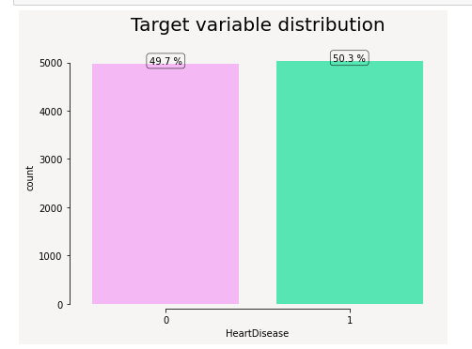
Target Variable distribution

Slide 6
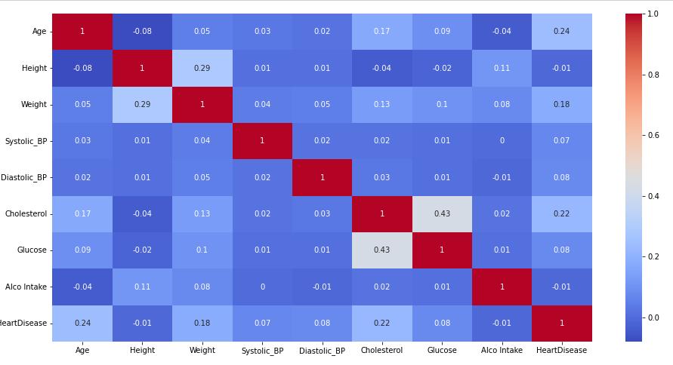
Correlation matrix

Slide 7
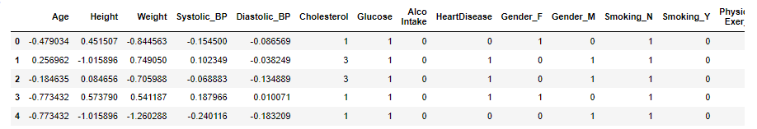
Data preprocessing steps
Converting age columns from number of days to age in years.
Filling missing values with median.
One-hot encoding method to convert categorical data to binary representation of data.
Standard Scaler normalization to normalize the data.

Slide 8
Feature selection
For Feature selection methodology, we are using RFE(Recursive Feature Elimination) which hunts for a subset of features by initiating with all features in the training dataset and efficiently deleting features until the desired number of features are left. We are using logistic regression as an algorithm used to choose features and specify count as 10.

Slide 9
Machine learning models
The Following Machine Learning classification algorithms have been considered for comparing their performance based on the heart disease data.
Logistic Regression
K Nearest Neighbor (KNN)
Decision Trees
Random Forest
Extreme Gradient Boosting
Stochastic Gradient Descent

Slide 10
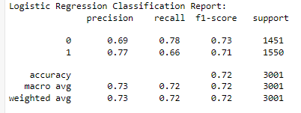
LOGISTIC REGRESSION
Modeling the likelihood of a discrete result given an input variable is what logistic regression does. The most popular logistic regression models simulate a binary outcome, such as true or false, yes or no, etc.

Slide 11
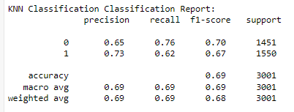
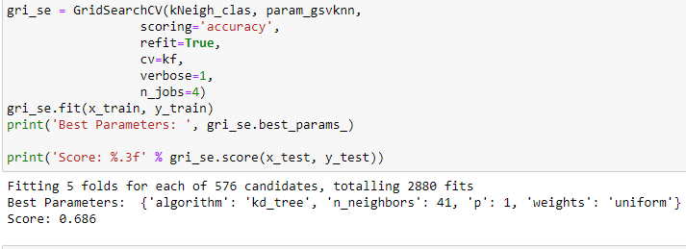
K Nearest Neighbor (KNN)
It is predicated on the notion that the observations in the data set that are "most similar" to a given data point are those that are closest to it. As a result, we can categorize the unexpected points using the values of the existing observations that are closest to them.
Find the K-value is an important task in implementing KNN. For which I have used GridSearchCV for hyper-parameter tuning.

Slide 12
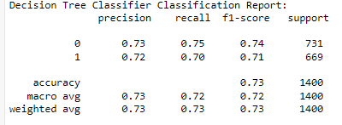
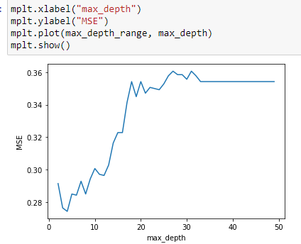
Decision Trees
The term itself implies that it displays the predictions using a flowchart that resembles a tree structure. The decision is made by the leaves at the end, which follows the root node.
Finding the depth at which the accuracy is more is main task in this approach for which I calculated Mean Squared Error for each value within range 1-50 and concluded with depth as 4 because at that point MSE value is close to zero.

Slide 13
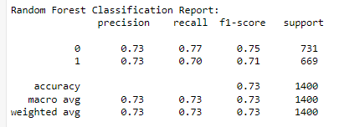
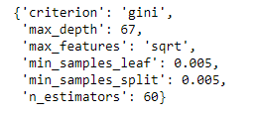
Random Forest
Random Forest is a classifier that uses a number of decision trees on various subsets of a given data set and averages the results to increase the predicted accuracy of that data set.
Tuning mechanism: GridSearchCV.

Slide 14
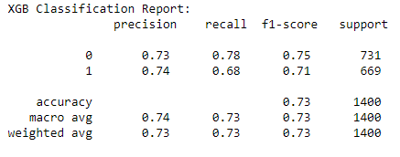
Extreme Gradient Boosting
XGB stands for Extreme Gradient boosting which is a decision-tree-based ensemble Machine Learning algorithm that uses a gradient boosting framework to design our model.

Slide 15
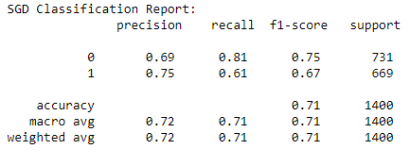
Stochastic gradient descent
Is one of the Gradient Descent approach which uses each single data point to minimize the loss instead of whole dataset.
Used parfit as hyper-parameter tuning mechanism.

Slide 16
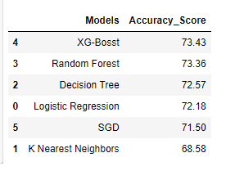
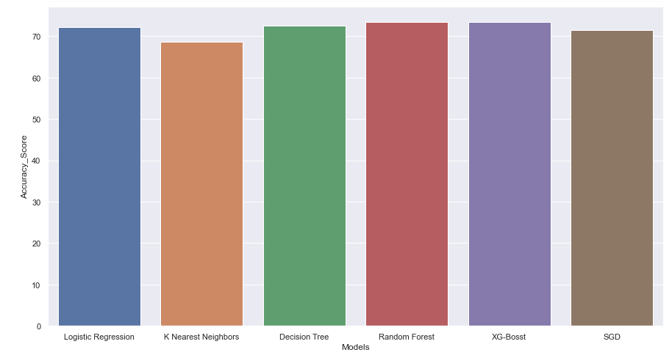
Final Evaluation Results
From graph of Models vs Accuracy Score, XGB Model is best fit model for this dataset with accuracy 73.43%.

Slide 17
Conclusion and references
From the algorithms implemented Logistic regression, KNN, Random Forest, Decision tree, Extreme Gradient Boosting, Stochastic gradient descent.
Extreme Gradient Boosting(XGB) has performed well with high accuracy.
References:
https://machinelearningmastery.com/gentle-introduction-xgboost-applied-machine-learning/
https://www.analyticsvidhya.com/blog/2015/06/tuning-random-forest-model/
https://machinelearningmastery.com/rfe-feature-selection-in-python/
https://scikit-learn.org/stable/modules/grid_search.html

Slide 18
Thank you

